Slide 1


Special topics
Session 13
Al-Zahra university
Maryam zim
@maryamzim maryamxiim@gmail.com

Slide 2
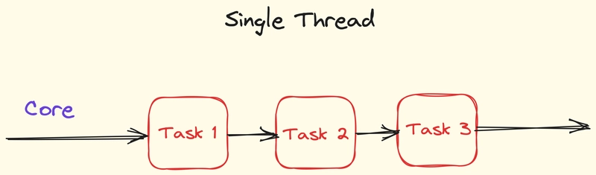
What is Single-threaded ?
JavaScript is normally single-threaded, meaning it only does one thing at a time.
Imagine you have a kitchen where only one cook works. This cook has only two hands and can only focus on one knife or one pot at a time. He can't chop onions and wash dishes at the same time. He does things one at a time.
In the computer world:
Thread: It's like the cook who executes the commands.
Single-threaded:: This means that JavaScript executes only one line of code at a time.

Slide 3
Blocking:
Imagine you walk into a restaurant. There is only one waiter.
The waiter takes your order.
He goes to the kitchen and waits there until the food is ready.
During this time, he doesn't take any other orders. Other customers wait in line.
When the food is ready, he gives it to you and then moves on to the next person.
Result: The entire system is "locked" or blocked because one dish is being prepared.
Non-blocking:
The waiter takes your order.
He delivers the order to the kitchen, gives you a receipt (or a shaker), and immediately moves on to the next customer.
The kitchen (in the background) is busy cooking. The waiter is taking new orders.
When your food is ready, a bell rings and you collect your food.
Result: no one is kept waiting. It is a non-blocking system.
In the world of JavaScript (code), JavaScript is essentially like a waiter. It has only one arm (single-threaded). If you give it too much work, it can lock up the entire page.

Slide 4
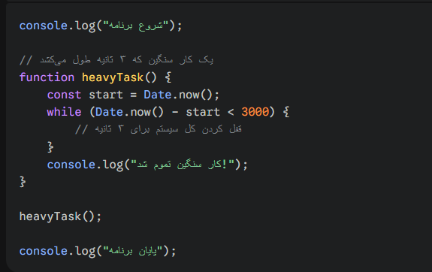
Blocking Example:
Suppose you have a very large loop that is time consuming.
Output:
1. Starting the program
2. (3 seconds pause - user cannot click any button)
3. The hard work is done!
4. Ending the program

Slide 5
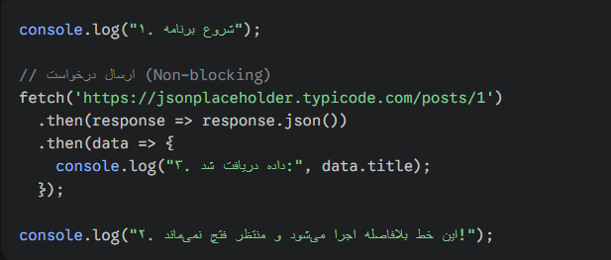
Non-blocking example:
Now we do the same thing with a non-blocking method like fetch.
Suppose you have a very large loop that is time consuming.
Output :
The order in which the messages will be printed in the console will be as follows:
1. Program start
2. This line will be executed immediately... (because the fetch has not blocked the path)
3. Data received: (This message appears when the response arrives from the server, which usually takes a few milliseconds or seconds)

Slide 6
Synchronous:
Like a bakery queue. The second person doesn't get their turn until the first person gets their bread. If the baker goes on a break for half an hour, the whole queue stops.
Asynchronous:
Like a restaurant. You order and get a receipt. The chef starts cooking, but the waiter can also take the next person's order. When your food is ready, you get a call.
Why do we need Async on the web?
Because it takes time to get information from the server. If our code waits for the server to respond, the entire site will "freeze" and the user won't be able to click a single button.

Slide 7
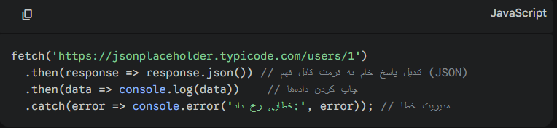
What is API?
API stands for Application Programming Interface. Imagine you are in a restaurant (Frontend), the kitchen is the server (Backend). You can't go directly to the kitchen! The waiter is the API. He gives you the menu, takes the order, takes it to the kitchen and returns the food to you.
In the web world, an API is an address to which we send a request and it returns data to us (usually in JSON format).
Fetch Method:
fetch is the standard JavaScript tool for sending a request to the server. This method gives us a Promise. That is, it says: "I'm going to fetch the data now, I promise you either I'll fetch the data or I'll tell you why it didn't work!"

Slide 8
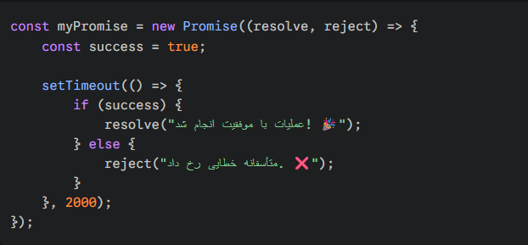
The concept of Promise:
Imagine you order a pizza from a fast food restaurant. The chef gives you a vibrating device (Pager). This device is actually a Promise:
1. Pending: The device is currently silent. The pizza is not ready yet (the code is running).
2. Fulfilled: The device vibrates! The pizza is ready and you get your food (the data was received successfully).
3. Rejected: The chef comes out and says, unfortunately, we are out of cheese and we cannot serve the pizza (an error occurred).
Structure of a Promise:
A promise is created with the keyword new Promise and takes a function that has two inputs: resolve (for success) and reject (for failure).

Slide 9
How to use promises?
When we have a promise, we need to listen to it to find out what the result was:
.then(): This part is executed when the promise is resolved successfully (resolve).
.catch(): This part is executed when the promise fails (reject).
.finally(): This part is executed in both cases (such as when the restaurant closes).

Slide 10
Advanced Promise Methods:
Sometimes we have multiple promises and we want to manage them together:
Promise.all([p1, p2, p3]): Waits for all promises to succeed. If even one fails, all of them fail. (Good for when we need information from multiple sources at the same time).
Promise.race([p1, p2, p3]): Whichever one responds first (whether successful or unsuccessful), returns the same. (Like a race).
Promise.allSettled(): Waits for everyone's task to be clear (it doesn't matter whether they fail or succeed).

Slide 11
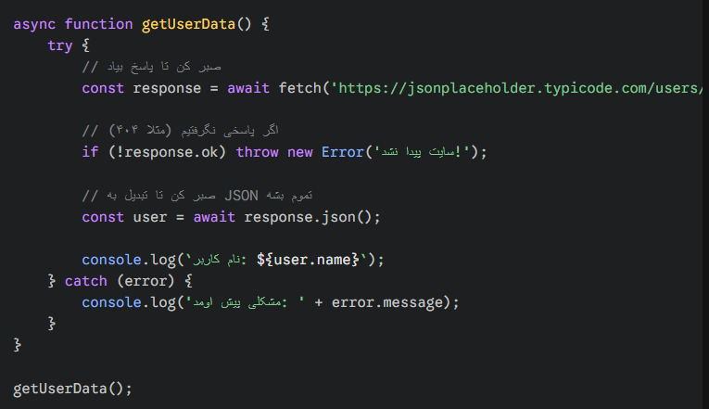
Async / Await:
Using .then() sometimes makes the code cluttered. In modern JavaScript, we use the keywords async and await, which make asynchronous code look like synchronous code (line by line).
async: comes before the function definition and says that this function has asynchronous operations.
await: comes before the fetch command and says: "Wait here until the server responds, then go to the next line."
Example with Async/Await:

Slide 12
POST method in fetch:
Imagine that you have only read magazines (GET), but now you want to write a letter yourself and post it to the magazine office (POST).
On the web, when you fill out a registration form or leave a comment, you use the POST method.
For this, we still use the same fetch function, but we need to tell it that this time it is not just a simple request and that we have "content" with it.
POST request structure in Fetch:
When we want to send data, the fetch function takes two inputs:
1. The API address
2. A settings object (Options) that contains the method, headers, and the data body.
Example code:

Slide 13
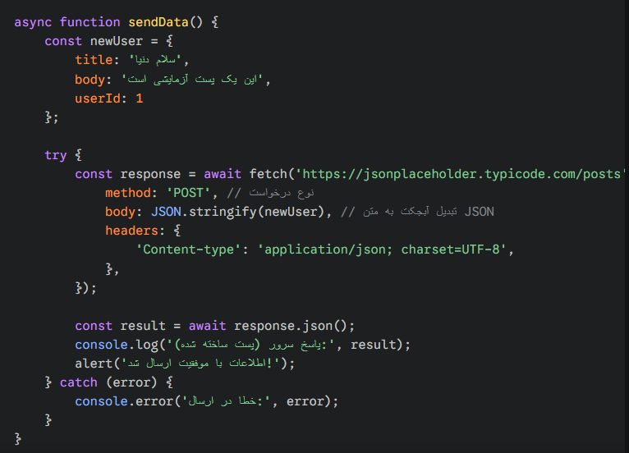
Why do we use JSON.stringify?
This is very important for students: the Internet cannot transport "JavaScript objects". The Internet only understands strings or text.
JSON.stringify(obj): Converts our object into a long string to pass over the network wires.
Content-type: We tell the server: "Hey server! What I'm sending you is not plain text, it's JSON formatted; so interpret it as such."

Slide 14
Local Storage:
Local Storage allows us to store data in the user's browser's permanent memory so that the information remains even when the browser is closed and reopened.
Local Storage Features:
1. Permanence: Data remains until it is manually deleted (by the user or our code).
2. Capacity: About 5-10 MB (much more than cookies).
3. Text only: Local Storage can only store Strings. (This is key!)

Slide 15
Four main commands:
Working with Local Storage is very simple and has a total of 4 main methods:
Operation | Method | Description | Example
Create / Update | localStorage.setItem('key', 'value') | Stores a data item with a specific key name. | setItem('theme', 'dark')
Read | localStorage.getItem('key') | Retrieves the data value associated with the key. | getItem('theme')
Delete One | localStorage.removeItem('key') | Removes a specific item from storage by its key. | removeItem('theme')
Delete All | localStorage.clear() | Wipes all local storage data for the current domain. | clear()

Slide 16
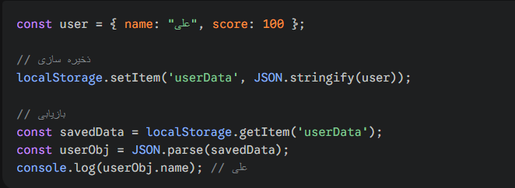
The Challenge of Storing Objects and Arrays :
As I said, Local Storage only understands text. So what if we want to store an object? Again, we turn to our old friend JSON.
When storing: we convert the object to a string: JSON.stringify()
When reading: we convert the string back to an object: JSON.parse()

Slide 17
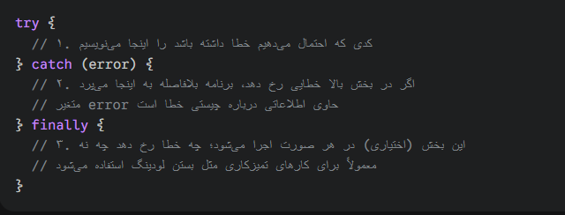
Try/Catch/Finally:
try/catch is like a “safety net” in tightrope walking. In programming, errors are inevitable (for example, the internet goes down, the server doesn’t respond, or the user enters incorrect input). If you don’t handle these errors, your entire application will “crash” and stop working.
The try/catch/finally construct allows you to anticipate and handle errors without stopping the program.

Slide 18
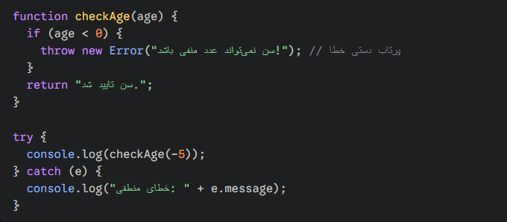
Throwing an error manually:
(throw) Sometimes, from the JavaScript perspective, there is no error, but from the logic of our program, there is an error condition (for example, the user's age is negative). In this case, we use the throw keyword.

Slide 19
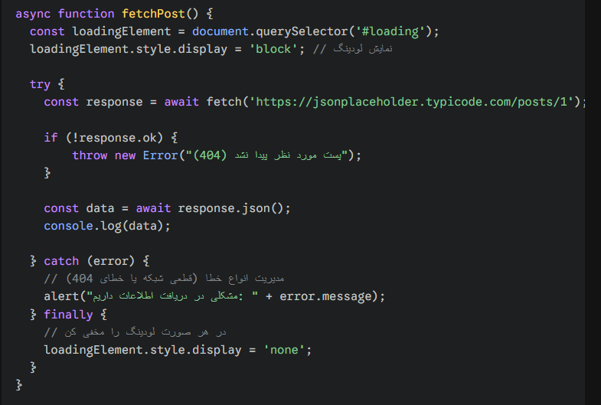
Use in asynchronous operations (Async/Await):
This is the most commonly used case. When working with fetch, we must use try/catch because the internet may be down.
What does the error object contain?
When an error is caught in catch(error), the object usually has two important properties:
1. error.name: The type of error (e.g. ReferenceError or SyntaxError).
2. error.message: The text of the error message that explains what happened.
3. error.stack: (for debugging) tells you on which line and in which file the error occurred.

Slide 20
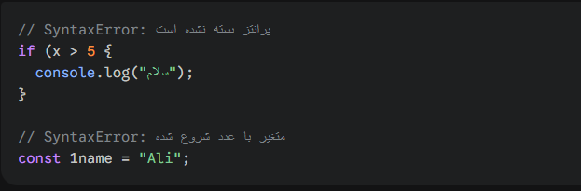
Types of errors:
We have 3 types of errors in javascript:
1. SyntaxError - "Granny error“:
This error occurs when you have not followed the rules of JavaScript syntax. The JavaScript engine cannot understand or translate the code that is written incorrectly at all.
When does it occur?
Before the code starts executing.
Example: You have not closed the parentheses, you have a typo in the keywords (such as funtion instead of function), or you have not included a comma.
Example code:

Slide 21
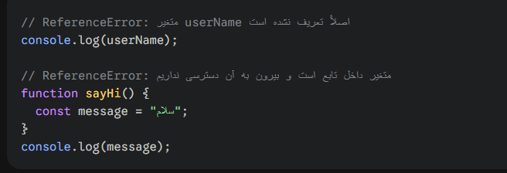
Types of errors:
2. ReferenceError - "Wrong address"
In this case, your syntax is perfectly correct, but you are referring to something that does not exist or is not available. This means that the JavaScript engine understands the code, but when it tries to execute it, it finds that the variable or function cannot be found in memory.
When does it happen? At runtime.
Example: Calling a variable that is not defined, or using a variable that is in another scope.
Example code:

Slide 22

Types of errors:
3. TypeError:
This is when a "reference" exists, but you're doing something with it that it doesn't know how to do. For example:

